Slide 1
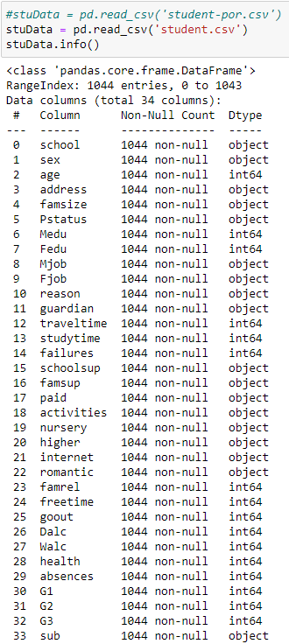
DATA
SET
CLEANING
Total 1044 entries
34 variables
Numerical and categorical
Notes:
We found that the data set consists of a total of 1044 entries with 34 unique numerical and categorical variables.

Slide 2
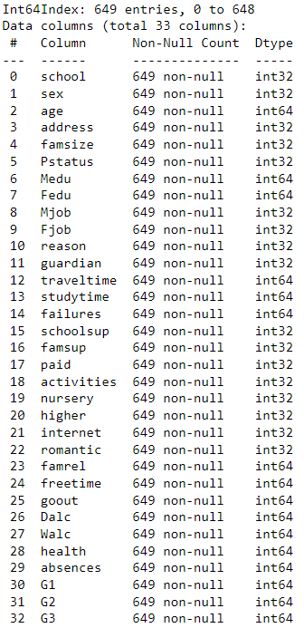
DATA
SET
CLEANING
PREPARATION
37.8% of data are on students’ math results
649 entries left after removal
Notes:
We also found out that the data contained entries of students’ maths results, hence we decided to clean the data as we only require data regarding the students’ language results.

Slide 3

DATA
CLEANING
PREPARATION
37.8% of data are on students’ math results
649 entries left after removal
Converted all data type to int
Generated column for average grades of students
Notes:
As the data only contained information on each student’s grades for 3 different tests, we wanted an easier way to analyse the data, hence we generated another column for the average grades of the students

Slide 4
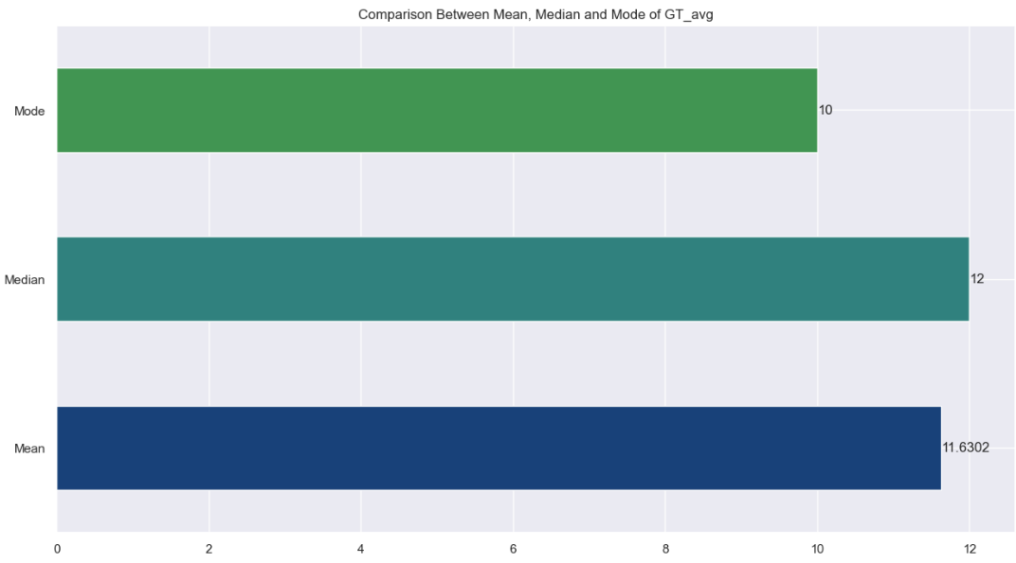
DATA PREPARATION
EXPLORATORY DATA ANALYSIS
Mode, Median and Mean of Average Grades
Generated column for average grades of students
Mode : 10
Median : 12
Mean : 11.6
Notes:
Here we can see the mode, median and mean of the average grades of the students.

Slide 5
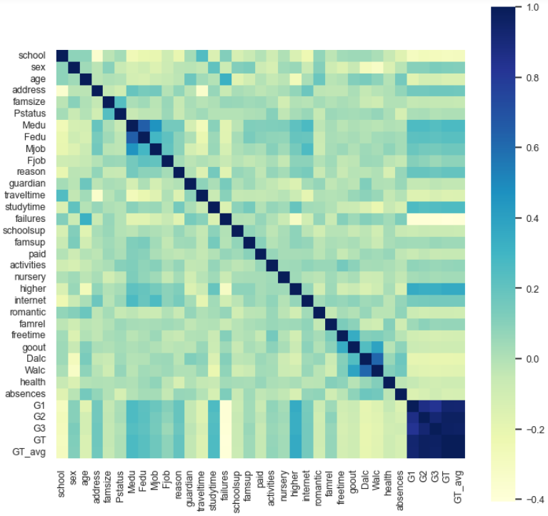
DATA PREPARATION
EXPLORATORY DATA ANALYSIS
Generated column for average grades of students
Correlation matrix
Some variables to take note of :
Higher (Whether student wants to pursue higher education)
Medu (Mother’s Education level)
studytime (Number of hours spent)
Fedu (Father’s Education level)
Failures (Number of past failures)
Dalc (Weekday alcohol intake)
Interesting variables
Average scores
Age
Absences
Notes:
To start off our Exploratory Data Analysis, we used a correlation matrix to see how each variable correlated to the average grade.
Some significant variables we found that had high correlation to the average grades were Higher, which is whether the student wants to pursue higher education, the mother’s education level, studytime, Father’s education level, number of past failures and their alcohol intake on weekdays.
It is important to note that these past failures are not inclusive of the 3 tests that are in the data.

Slide 6
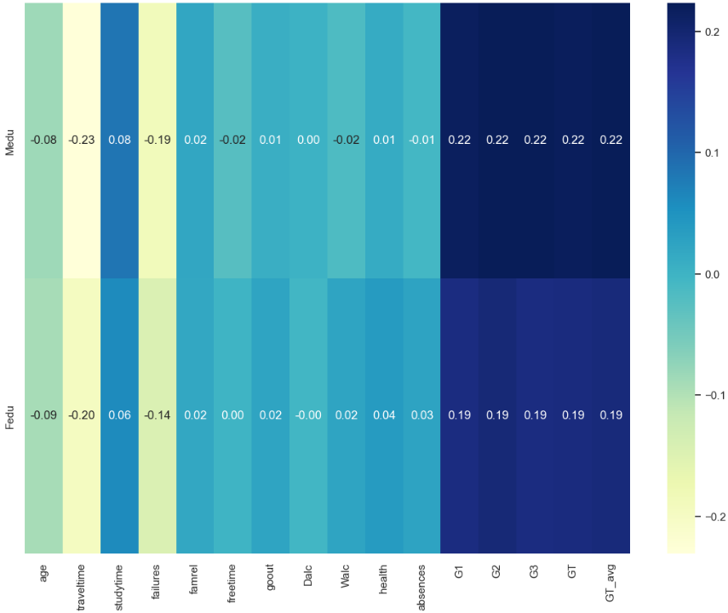
EXPLORATORY DATA ANALYSIS
Parent’s Education
Both Medu (Mother’s education) and Fedu (Father’s education) have a positive correlation with other variables
Students tend to perform better, have better health, lesser absences and better study habits.
Correlation matrix
Some variables to take note of :
Higher (Whether student wants to pursue higher education)
Medu (Mother’s Education level)
studytime (Number of hours spent)
Fedu (Father’s Education level)
Failures (Number of past failures)
Dalc (Weekday alcohol intake)
Interesting variables
Average scores
Age
Absences
Notes:
For the students’ parents’ education, both the mother and father’s education level has a positive correlation with other variables. We noticed that students tend to perform better in school, are healthier with less absences and have better study habits.

Slide 7
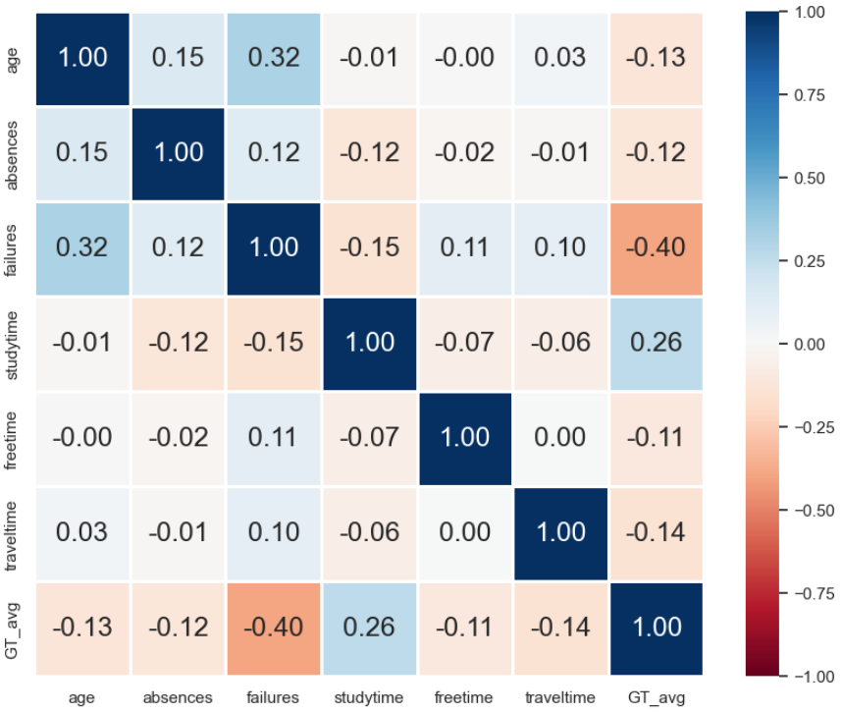
EXPLORATORY DATA ANALYSIS
Interesting variables
Age
Absences
Failures
Study Time
Free Time
Travel Time
Notes:
Other interesting variables we found were these, but we will only be going through some in this video.

Slide 8
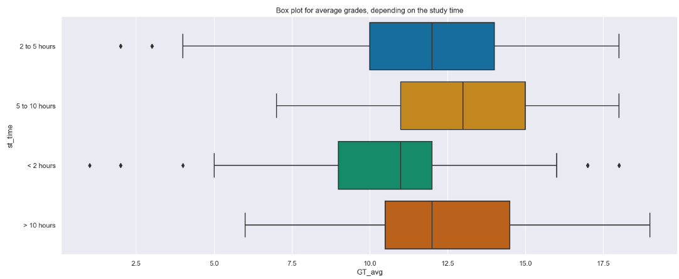
EXPLORATORY DATA ANALYSIS
Interesting variables
Study Time
Age
47% of students spend around 2 to 5 hours studying
32.7% of students spend less than 2 hours studying
Absences
Failures
Free Time
Travel Time
Students who spend less than 2 hours have the lowest median average grades
Students spending more than 5 hours show a higher median average grade
Notes:
For study time, we found that the majority of students spend around 2 to 5 hours studying per week and another big portion of students spend less than 2 hours studying.

Slide 9
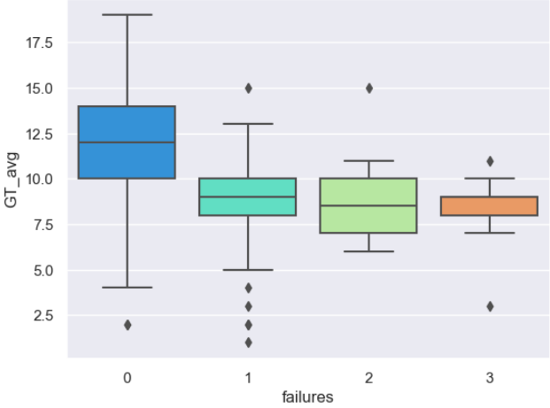
EXPLORATORY DATA ANALYSIS
Interesting variables
Study Time
Students who spend less than 2 hours have the lowest median average grades
Students spending 5 to 10 hours show a higher median average grade
47% of students spend around 2 to 5 hours studying
32.7% of students spend less than 2 hours studying
Failures
Students with lesser past failures tend to have higher average grades
Students may have a stronger foundation, hence easier to perform well subsequently
Negative correlation with total grade average
Notes:
From the box-plot, we can see that students who spend less than 2 hours have the lowest median average grades whereas students spending 5 to 10 hours show a higher median average grade.

Slide 10
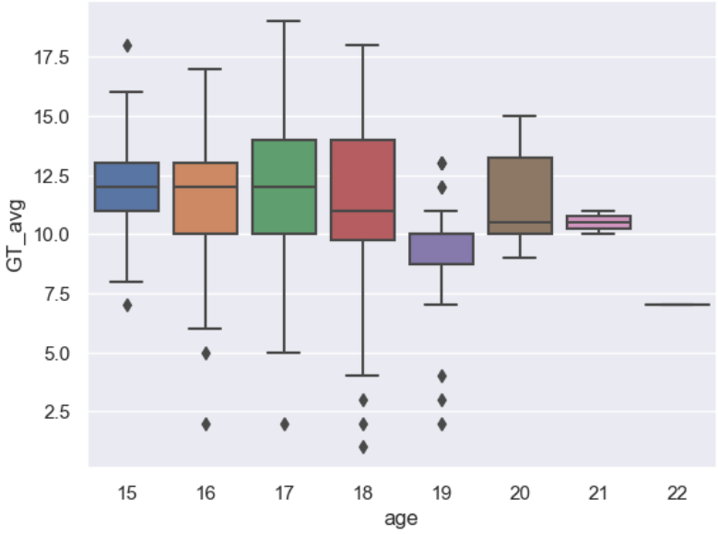
EXPLORATORY DATA ANALYSIS
Interesting variables
Failures
Study Time
Students with lesser past failures tend to have higher average grades
Students may have a stronger foundation, hence easier to perform well subsequently
Negative correlation with total grade average
Students who spend less than 2 hours have the lowest median average grades
Students spending 5 to 10 hours show a higher median average grade
Age
As student’s age increase, their median grade tend to decrease
Negative correlation with total grade average
Notes:
For past failures, students with lesser past failures tend to have higher average grades. This shows that these students may have a better foundation, which leads to easier learning

Slide 11
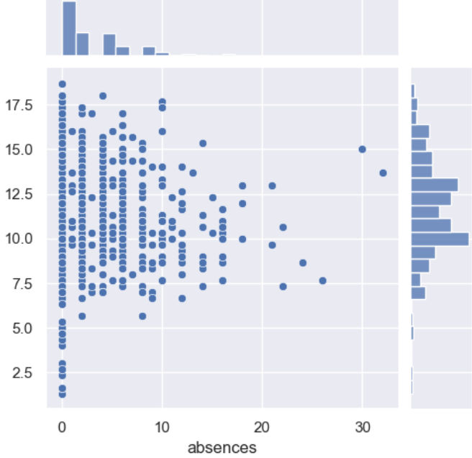
EXPLORATORY DATA ANALYSIS
Interesting variables
Failures
Age
Students with lesser past failures tend to have higher average grades
Students may have a stronger foundation, hence easier to perform well subsequently
As student’s age increase, their median average grade tends to decrease
Absences
An increase in absences leads to lower median average grades.
Negative correlation with total grade average
Notes:
For Age, we found that as a student gets older, their median average grade tends to be lower.

Slide 12
EXPLORATORY DATA ANALYSIS
Interesting variables
Age
Absences
As student’s age increase, their median average grade tends to decrease
An increase in absences leads to lower median average grades.
Negative correlation with total grade average
Notes:
For Absences, the student’s median average grades get lower as the absences increase.

Slide 13
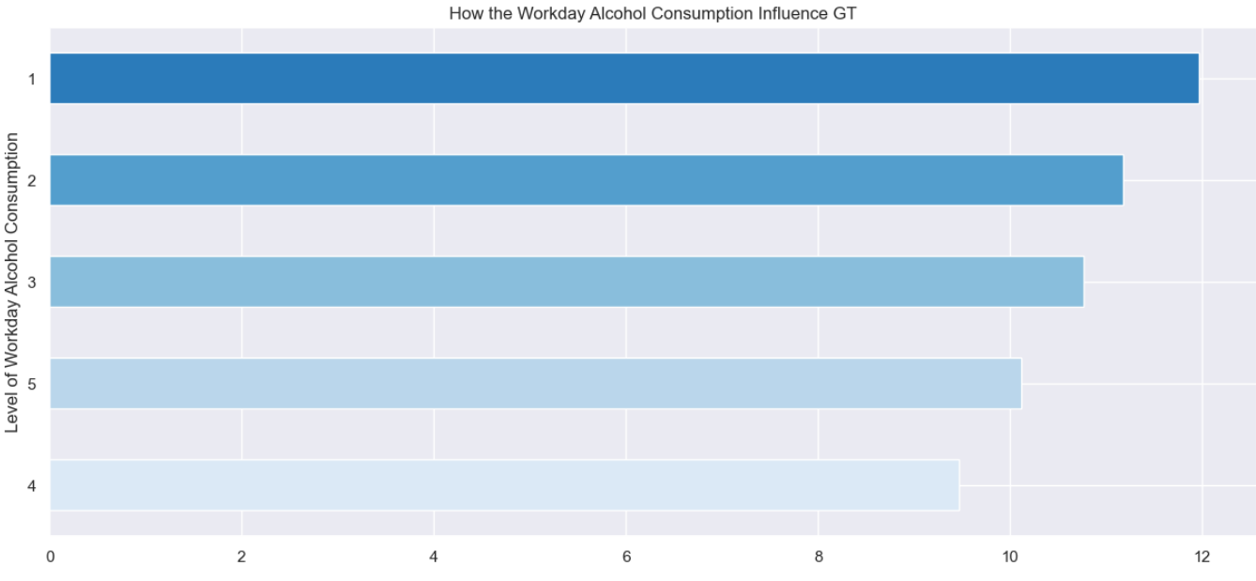
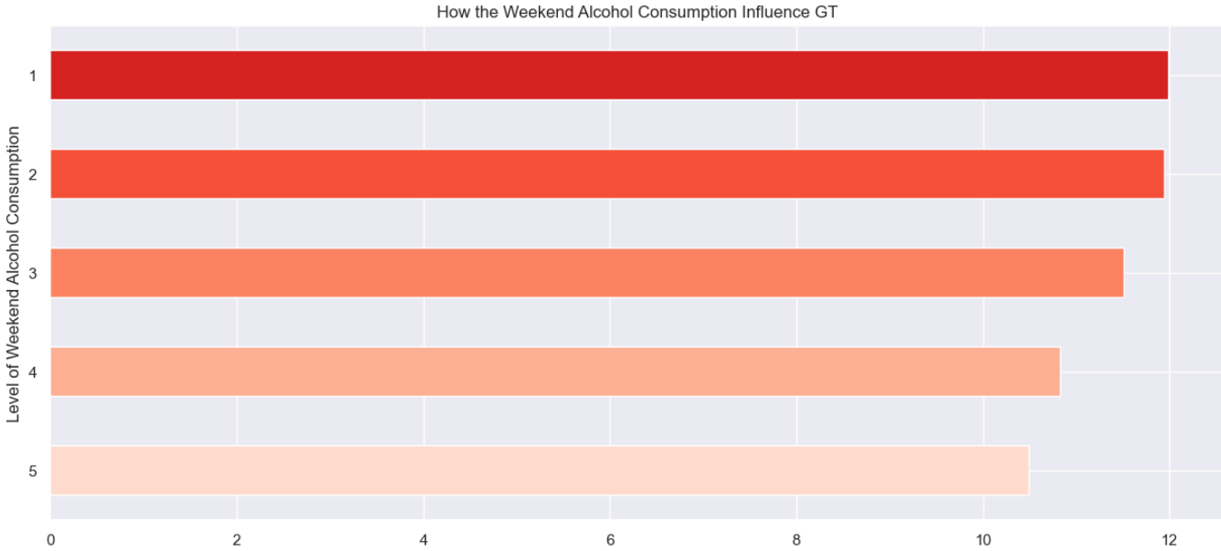
EXPLORATORY DATA ANALYSIS
Interesting variables
Alcohol Consumption – Dalc (Weekday) and Walc (Weekend)
Absences
An increase in absences leads to lower median average grades.
Negative correlation with total grade average
Both variables have a negative correlation to total grade average
Higher levels of alcohol consumption results in lower average total grade
Notes:
For the student’s alcohol consumption on both weekdays and weekends, the higher the level of alcohol intake, the lower the average total grade.

Slide 14
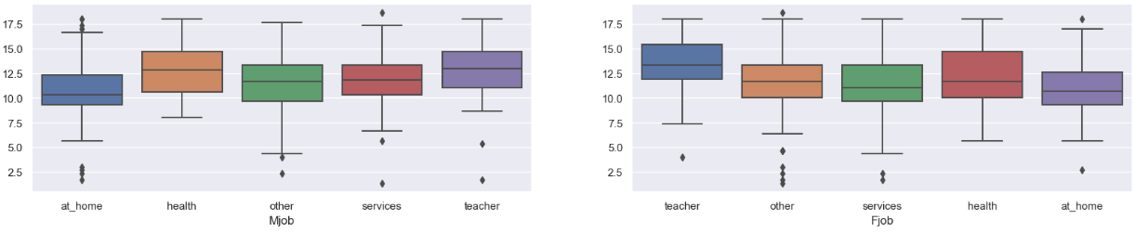
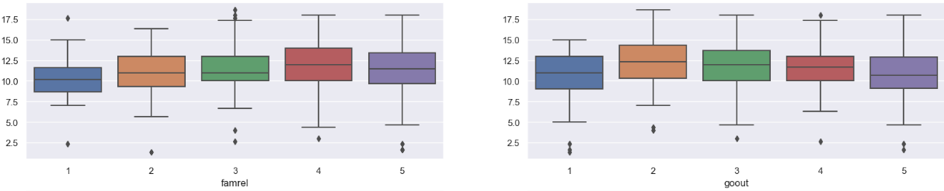
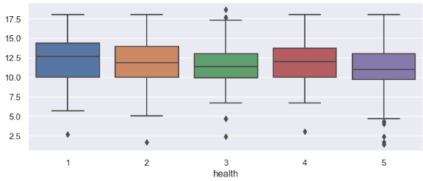
EXPLORATORY DATA ANALYSIS
Categorical variables
Alcohol Consumption – Dalc (Weekday) and Walc (Weekend)
famrel
goout
health
Mjob
Fjob
Both variables have a negative correlation to total grade average
Higher levels of alcohol consumption results in lower average total grade
Notes:
As mentioned previously, there are categorical variables in the dataset as well. These include the strength of their family relationship, how often they go out, the students’ health, and their parent’s jobs.

Slide 15
EXPLORATORY DATA ANALYSIS
Categorical variables
famrel
goout
health
Mjob
Fjob
We will be using One Hot Encoding (NEW) to encode the categorical features
Bring all features to the same scale
Access feature importance by coefficients of the linear regression model
Notes:
We will be using a new thing we learned, which is one-hot encoding, to encode the categorical features. This brings all the features to the same scale so we can assess the importance by coefficients of the linear regression model.

Slide 16
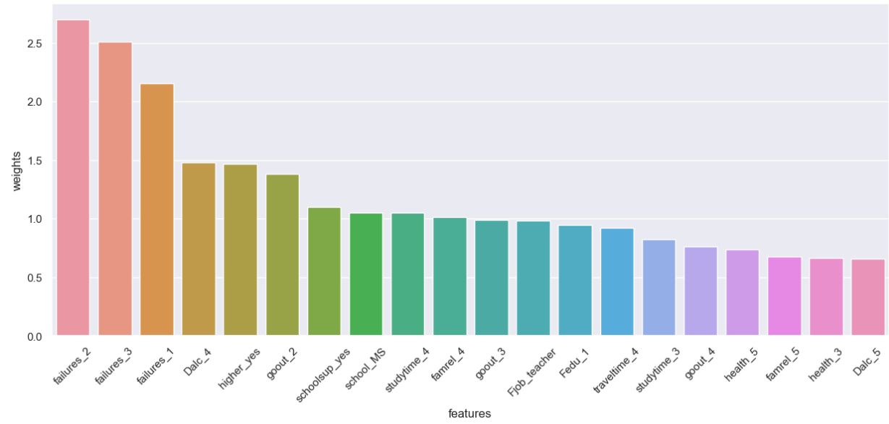
EXPLORATORY DATA ANALYSIS
Categorical variables
Feature importance
Notes:
As seen in the bar plot,

Slide 17
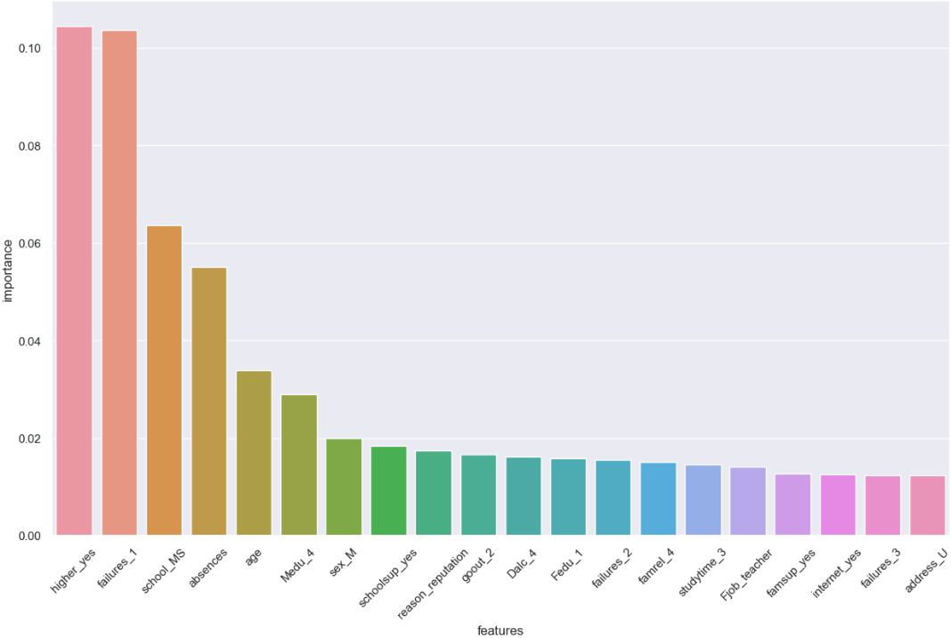
EXPLORATORY DATA ANALYSIS
Categorical variables
Feature importance – Random Forest
Notes:
We also used Random Forest to see the most important features that would affect grades.

Slide 18
MACHINE LEARINING
Decision Tree
Random Regression Model
Support Vector Regression Model
Notes:
Moving on to machine learning, we will be using a decision tree and two different regression models to aid us.

Slide 19
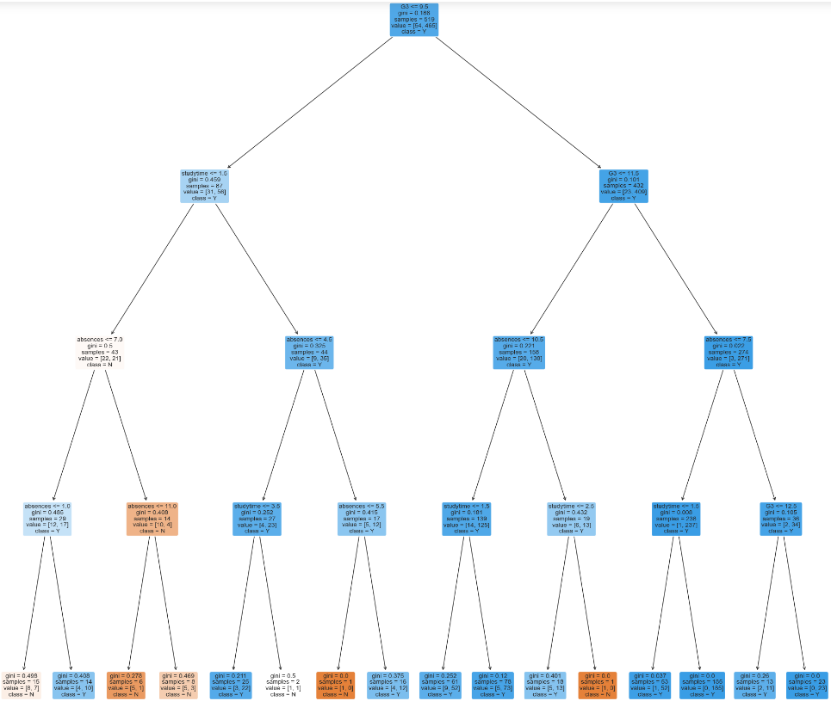
MACHINE LEARINING
Random Regression Model
Decision Tree
Maximum depth of 4
Support Vector Regression Model
Training and tests set at 4:1 ratio
Most important variables for predicting G3
Number of previous failures
Number of hours spent studying
Number of absences
Notes:
To build a predictive model for student performance, we used a decision tree classifier with 4 depths, splitting the dataset into training and test sets at a 4:1 ratio.
Based on the tree, we can also tell that thee most important variables for predicting G3 are Number of previous failures, Number of hours spent studying and the Number of absences

Slide 20
MACHINE LEARINING
Random Regression Model
Decision Tree
(Maximum depth of 4)
Most important variables for predicting G3
Support Vector Regression Model
Study time > 1.5 Hours
Failures <= 1
Absences <= 4.5
PASS
Study time > 1.5 Hours
Failures > 1
Absences >= 4.5
FAIL
Notes:
Based on the tree, if a student studies more than 1.5 hours per week, has fewer than or equal to 1 previous failure, and fewer than or equal to 4.5 absences, they are likely to pass the final exam
On the contrary, even if they study more than 1.5 hours per week, but have more than 1 previous failure and more than 4.5 absences, they are likely to fail

Slide 21
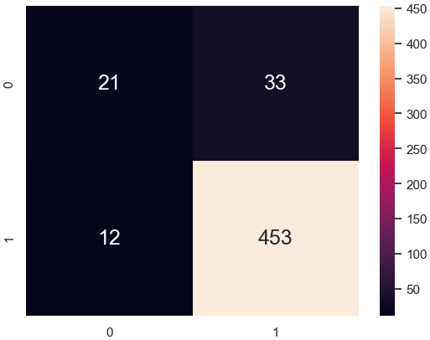
MACHINE LEARINING
Random Regression Model
Decision Tree
(Maximum depth of 4)
Support Vector Regression Model
Train set :
Accuracy : 91.33%
TPR: 97.42%
TNR: 38.88%
FPR: 61.11%
FNR: 2.58%
Study time > 1.5 hours
Failures <= 1
Absences <= 4.5
PASS
Study time > 1.5 hours
Failures > 1
Absences >= 4.5
FAIL
Notes:
On the training data set, the model has an accuracy of 91.33%, with a TPR of 97.42% and a FPR of 61.11%, indicating good performance in identifying positive examples but room for improvement in identifying negative ones.
This decision tree provides an interpretable way to understand the relationships between variables and student performance, with G1 being the most important factor in predicting G3.
However, the model's limited set of features means it may not be generalizable to all students.

Slide 22
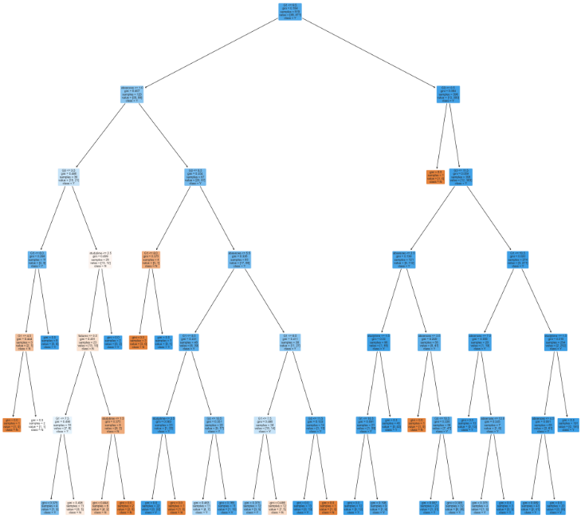
MACHINE LEARINING
Random Regression Model
Decision Tree
(Maximum depth of 6)
Most important variables for predicting G3
Support Vector Regression Model
Grades of first test (G1)
Number of hours spent studying
Number of absences
Accuracy : 91.33%
TPR: 97.42%
TNR: 38.88%
FPR: 61.11%
FNR: 2.58%
Most important variables for predicting G3
Study time > 1.5 hours
Failures <= 1
Absences <= 4.5
PASS
Study time > 1.5 hours
Failures > 1
Absences >= 4.5
FAIL
Notes:
Hence, we used a different tree classifier with a maximum depth of 6.
For this tree, the most important factors are G1, number of hours spent studying and the number of absences

Slide 23
MACHINE LEARINING
Random Regression Model
Decision Tree
(Maximum depth of 6)
Most important variables for predicting G3
Random Regression Model
Support Vector Regression Model
Accuracy : 91.33%
TPR: 97.42%
TNR: 38.88%
FPR: 61.11%
FNR: 2.58%
Lower average G3
G1<= 7.5
Study time <1.5 Hours
Absences > 3
Most important variables for predicting G3
Study time > 1.5 hours
Failures <= 1
Absences <= 4.5
PASS
Study time > 1.5 hours
Failures > 1
Absences >= 4.5
FAIL
Notes:
Based on the tree, students with a grade of 7.5 or lower for their first test, and study less than 1.5 hours with more than 3 absences have a lower average G3.

Slide 24
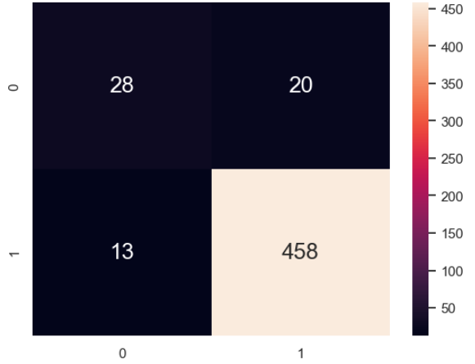
MACHINE LEARINING
Random Regression Model
Decision Tree
(Maximum depth of 6)
Support Vector Regression Model
Train set :
Accuracy : 93.64%
TPR: 97.24%
TNR: 58.33%
FPR: 41.67%
FNR: 2.76%
Notes:
In terms of model performance, the accuracy on the train data is 93.64%, indicating that the model correctly predicts the class labels for almost 94% of the observations
The TPR or sensitivity of the model is 0.9724 or 97.24%, which means that the model correctly predicts almost all of the positive cases
The TNR or specificity of the model is 58.33%, , which means that the model correctly predicts only 58.33% of the negative cases
The FPR of the model is 41.67%, indicating that the model incorrectly predicts 41.67% of the negative cases as positive.
Finally, the FNR of the model is 2.76%, which means that the model incorrectly predicts only 2.76% of the positive cases as negative.
These results suggest that the model is performing relatively well in terms of accuracy and TPR, but there is room for improvement in terms of the rest.

Slide 25
MACHINE LEARINING
Random Regression Model
Decision Tree
Random Regression Model
Support Vector Regression Model
(Maximum depth of 4)
(Maximum depth of 6)
Second set has higher accuracy
Higher TNR
Lower FPR
Accuracy : 91.33%
TPR: 97.42%
TNR: 38.88%
FPR: 61.11%
FNR: 2.58%
Accuracy : 93.64%
TPR: 97.24%
TNR: 58.33%
FPR: 41.67%
FNR: 2.76%
Grades of first test (G1)
Number of hours spent studying
Number of absences
Notes:
Upon comparing the two sets of outcomes, it is evident that the second has a superior TNR and lower FPR, indicating that the model is more proficient at accurately recognizing negative cases in the training data.
Nevertheless, the TPR and FNR are marginally inferior to the first set of results, suggesting that the model is slightly less capable of correctly identifying positive cases.

Slide 26
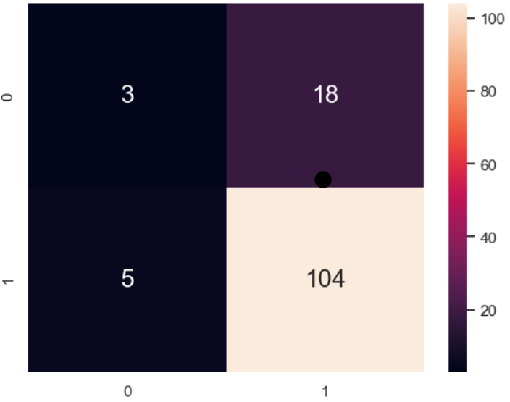
MACHINE LEARINING
Random Regression Model
Decision Tree
(Maximum depth of 6)
Random Regression Model
Support Vector Regression Model
Test set :
Accuracy : 82.30%
TPR: 95.41%
TNR: 14.28%
FPR: 85.71%
FNR: 4.58%
Grades of first test (G1)
Number of hours spent studying
Number of absences
Notes:
These are the results when we ran the model for the test set.

Slide 27
MACHINE LEARINING
Decision Tree
(Maximum depth of 6)
Random Regression Model
Support Vector Regression Model
Find hyperplane that best fits data by minimizing margin error between predicted and actual output
Grades of first test (G1)
Number of hours spent studying
Number of absences
Notes:
We wanted to improve the accuracy of our model and hence we decided to try something new.
Which is using the support vector regression model as it was proven to have higher accuracy than the random regression model.
It finds the hyperplane that best fits the data by minimizing the margin error between the predicted and actual outputs.

Slide 28
MACHINE LEARINING
Support Vector Regression Model
Decision Tree
(Maximum depth of 6)
Improving Model
Filtered and removed false positives
Used Support Vector Regression Model (SVR)
Find hyperplane that best fits data by minimizing margin error between predicted and actual output
R-squared value: 0.6585
Root mean squared error: 1.674
Grades of first test (G1)
Number of hours spent studying
Number of absences
Notes:
To improve the model we filtered out and removed the false positives of the data for all the input variables and used SVR on it.
The R squared value we got was 0.6585 which indicates that the SVR model explains 65.85% of the variance in the dependent variable, which is moderate.
The root mean squared error of 1.674 indicates that the average difference between the predicted and actual values of the dependent variable is 1.67 units, which may be considered acceptable depending on our context.

Slide 29
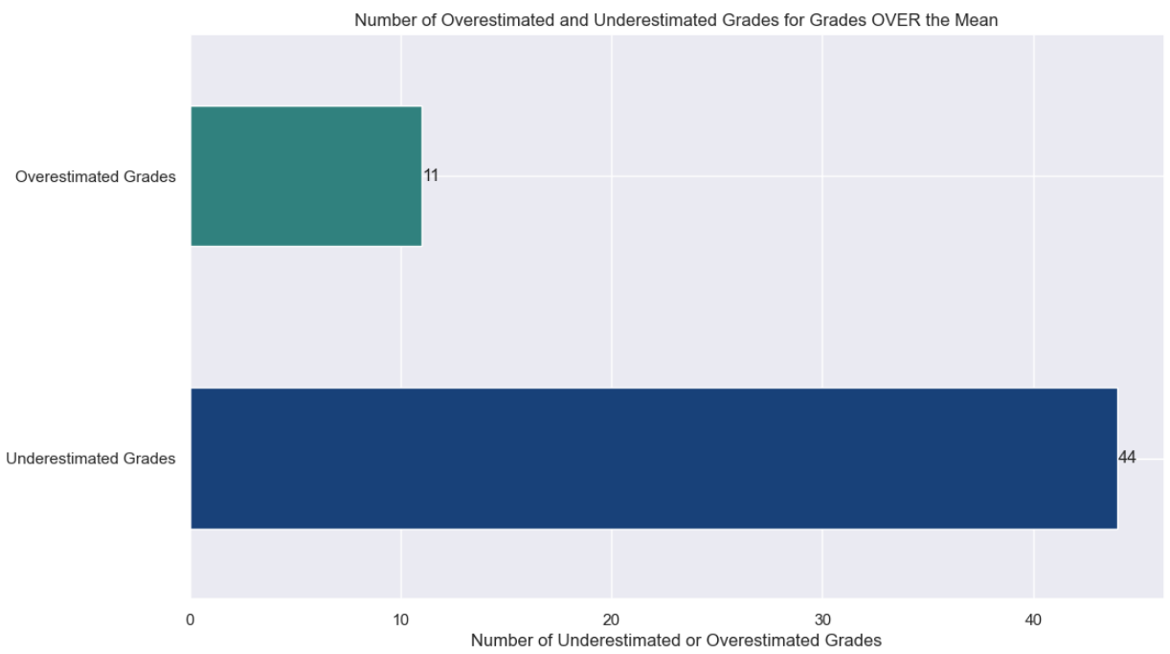
MACHINE LEARINING
Support Vector Regression Model
Decision Tree
(Maximum depth of 6)
Improving Model
Filtered and removed false positives
Used Support Vector Regression Model (SVR)
Overestimated and underestimated grades in train and test set are similar
Mean = 3:1 Ratio in test data
Not predicting well
Significant bias in model
Grades of first test (G1)
Number of hours spent studying
Number of absences
Notes:
To further reduce the difference between the predicted and actual values of the grades, we looked into overestimated and underestimated grades.
We found that they are similar in both the train and test set.
However the mean in the test data was in a 3:1 ratio.
This indicates that the model is not predicting well as there is a significant bias towards overestimating or underestimating the students grades.

Slide 30
MACHINE LEARINING
Support Vector Regression Model
Decision Tree
(Maximum depth of 6)
Improving Model
Remove outliers using quartiles
Re-ran SVR model
Not predicting well
Significant bias in model
R-squared value : 0.7518
Mean squared error (MSE) : 1.538
Grades of first test (G1)
Number of hours spent studying
Number of absences
Notes:
As such we want to further clean the data by removing outliers using the quartiles for all the variables inputed. Then we fed the data into the SVR model and ran it again.
This time, we achieved a r-squared value of 0.7518 and a mean squared-error of 1.538.
Comparing with the first set, it has a lower MSE and a higher R-squared value.
This indicates that the model performs better as it explains a greater proportion of the variability of the response data and has a smaller average deviation from the actual response values..
Overall, the second set of results demonstrated better performance than the first.

Slide 31
CONCLUSION
What we learned
Improving Model
Remove outliers using quartiles
Re-ran SVR model
One-Hot Encoding
Random Forest
Not predicting well
Significant bias in model
R-squared value : 0.7518
Mean squared error (MSE) : 1.5384
Support Vector
Regression model
Grades of first test (G1)
Number of hours spent studying
Number of absences
Notes:
As a conclusion, we have learned 3 new things from this project.

Slide 32
CONCLUSION
What we learned
Improving Model
Remove outliers using quartiles
Re-ran SVR model
Support Vector
Regression model
One-Hot Encoding
Random Forest
Not predicting well
Significant bias in model
R-squared value : 0.7518
Mean squared error (MSE) : 1.5384
Grades of first test (G1)
Number of hours spent studying
Number of absences
Encode Categorical Variables
Identify feature importance
Better Performance
Notes:
Firstly, one hot-encoding, which was used to encode categorical variables, which we then used random forest to identify the feature importance of each variable.
Finally, we used support vector regression model as it had a better performance compared to random regression model.

Slide 33



CONCLUSION
What we learned
Parents/Teachers can predict grades of students
Identify the areas affecting student
Better grades
Support Vector
Regression model
One-Hot Encoding
Encode Categorical Variables
Better Performance
Random Forest
Identify feature importance
Notes:
Overall, as a solution, parents or teachers can predict their student or child’s results and also see which areas are affecting their grades. Thereby, they can help them to achieve better grades.

Slide 34
CONCLUSION
Data Driven Insights
What we learned
Parents/Teachers can predict grades of students
Identify the areas affecting student
Better grades
Support Vector
Regression model
One-Hot Encoding
Higher education
Failures
Absences
Encode Categorical Variables
Better Performance
Random Forest
Identify feature importance
Notes:
For data-driven insights, in our context, the top three variables that are affecting a student’s grades are failures, absences and their desire for higher education.
As past failures greatly affect a student’s results, parents or teachers can intervene earlier to help the student build a strong foundation.
For absences, we feel that the students must be responsible for their own attendance, be it they have other activities or they are sick, they should refrain from missing school as much as possible.
Lastly, parents and teachers can help to change the mindset of students who do not desire a higher education and find out the reason behind it. As this is one of the major factors affecting their results.

